Slide 1
DataSpark: Illuminating Insights for Global Electronics
Comprehensive Exploratory Data Analysis
Harikrishnan G
14-10-2024

Slide 2
Objective: The primary objectives are to enhance customer satisfaction, optimize operations, and drive overall business growth. Problem statement: Global Electronics, a leading retailer of consumer electronics, faces challenges in understanding and utilizing their vast amounts of data effectively

Slide 3

Data Preparation:
Data Cleaning and Preprocessing

Slide 4
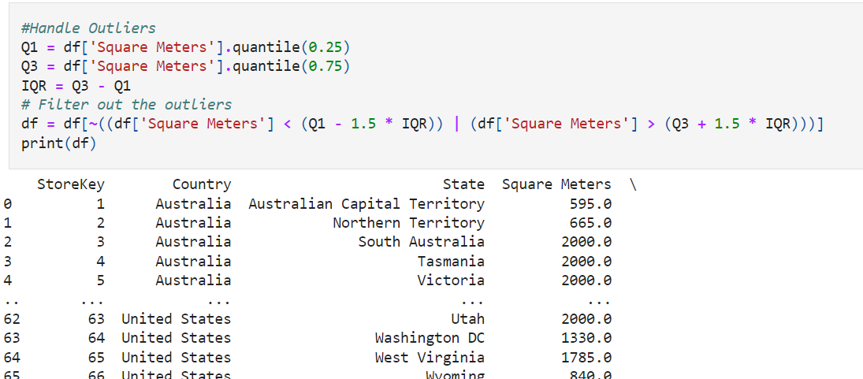
Handling outliers

Slide 5
Key Insights and SQL Queries

Slide 6
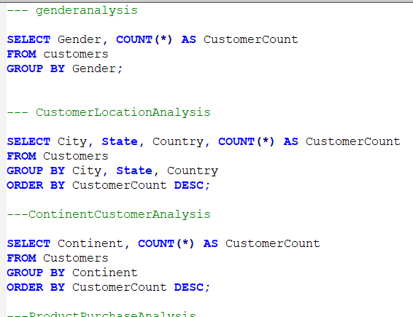

SQL queries to extract key insights

Slide 7
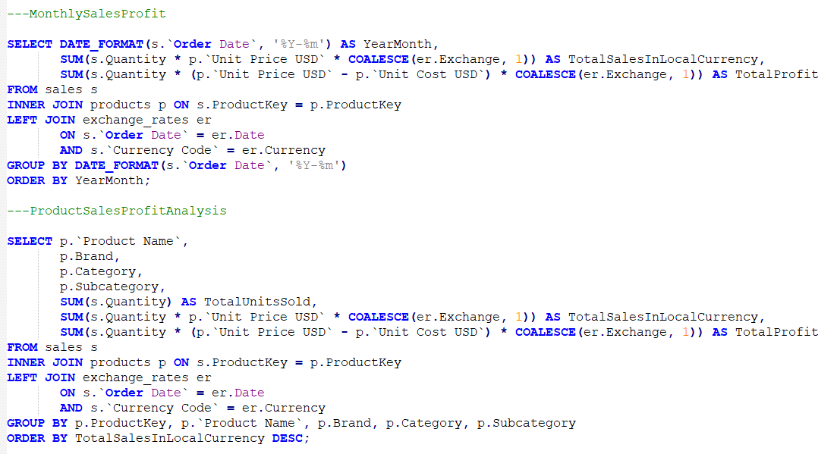

Slide 8
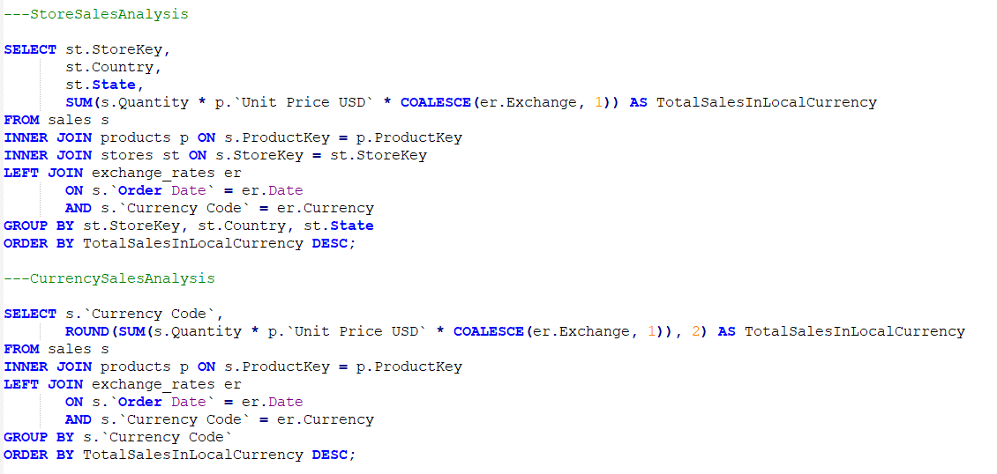

Slide 9
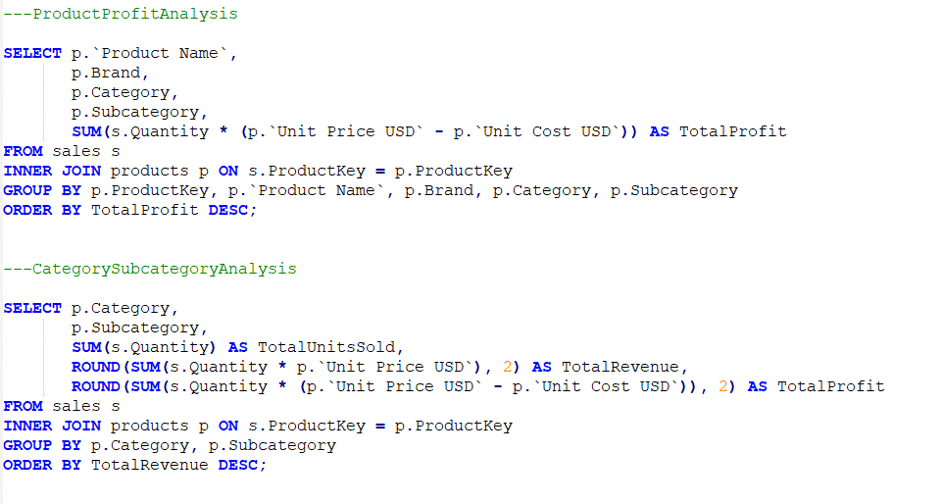

Slide 10


Slide 11
Visualizations Power BI

Slide 12
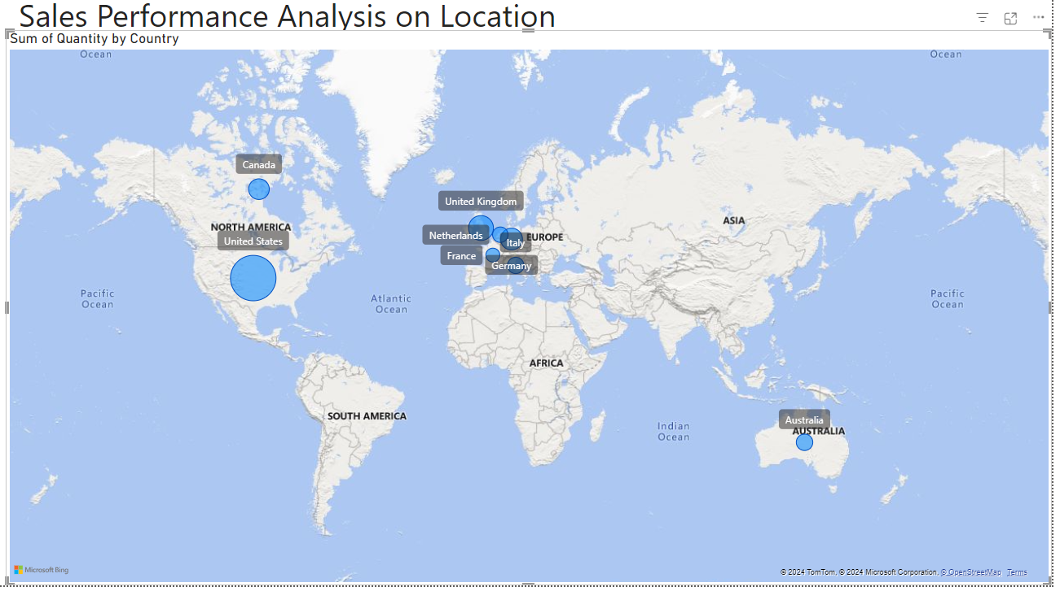

Slide 13
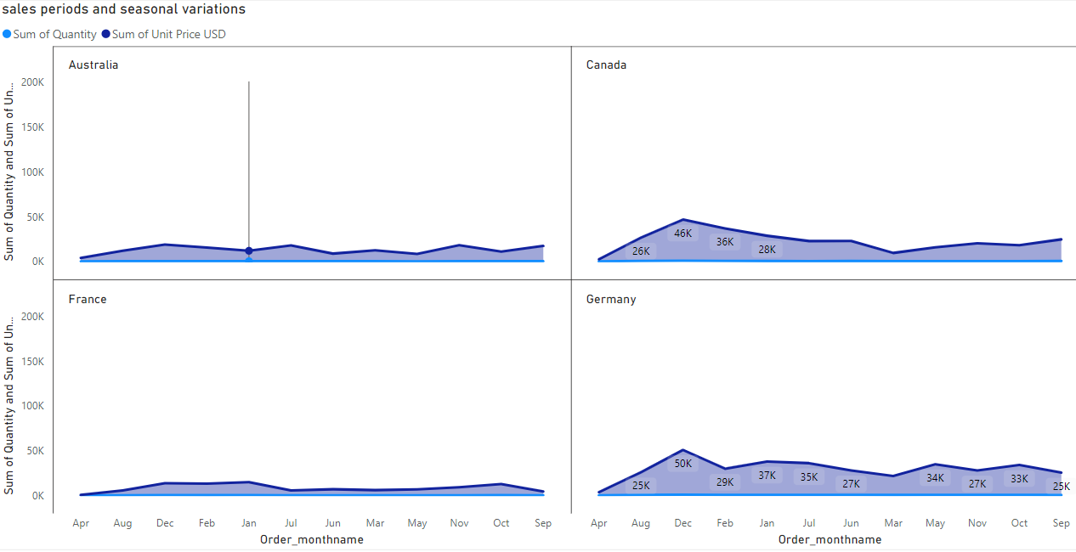

Slide 14
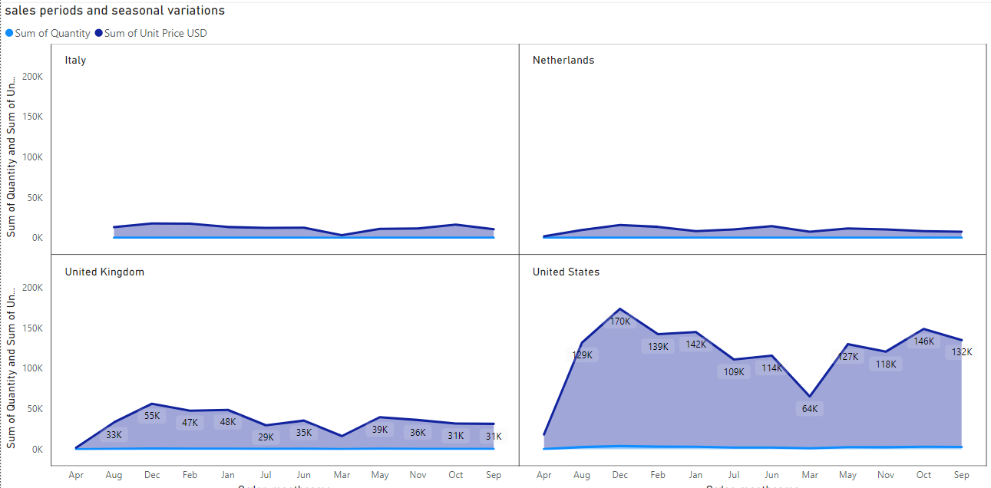

Slide 15
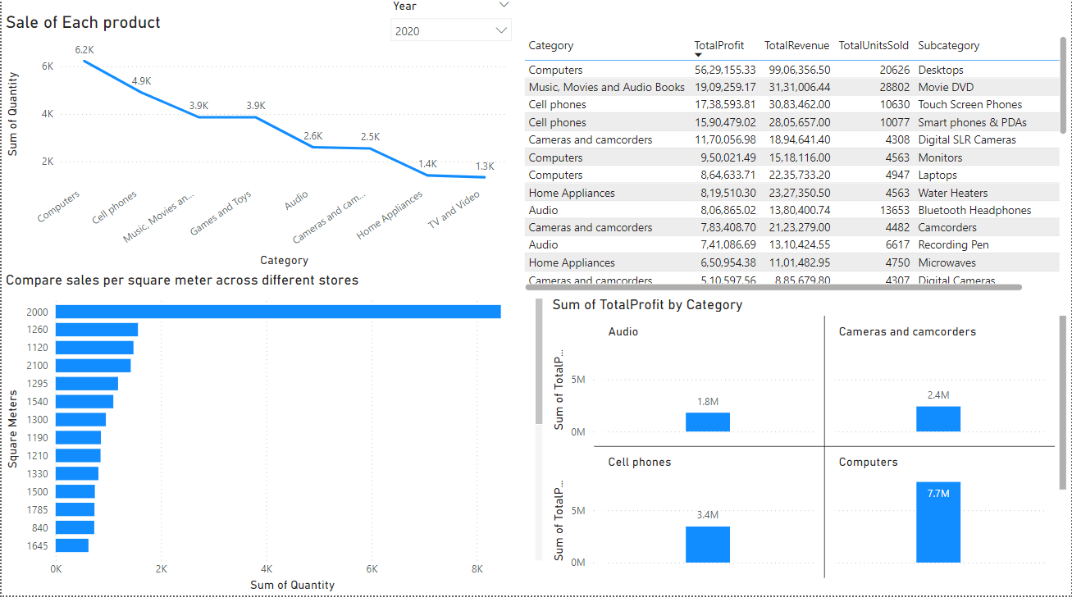

Slide 16
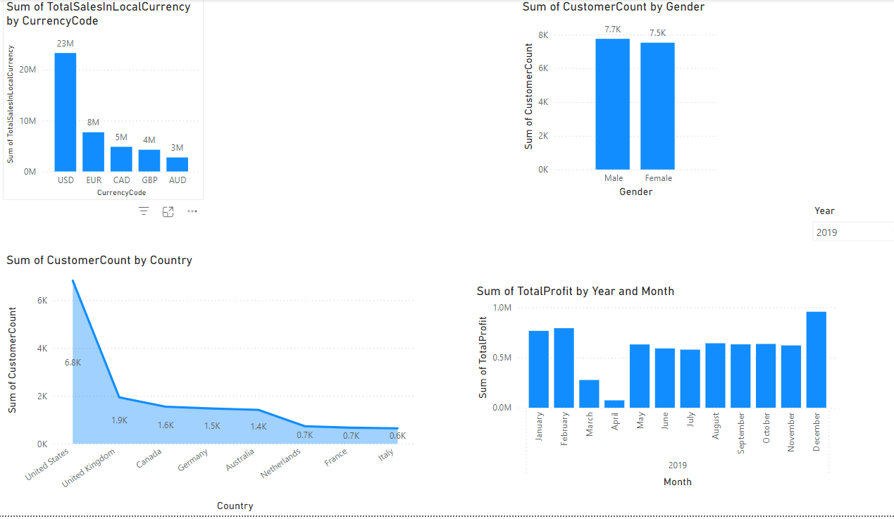

Slide 17
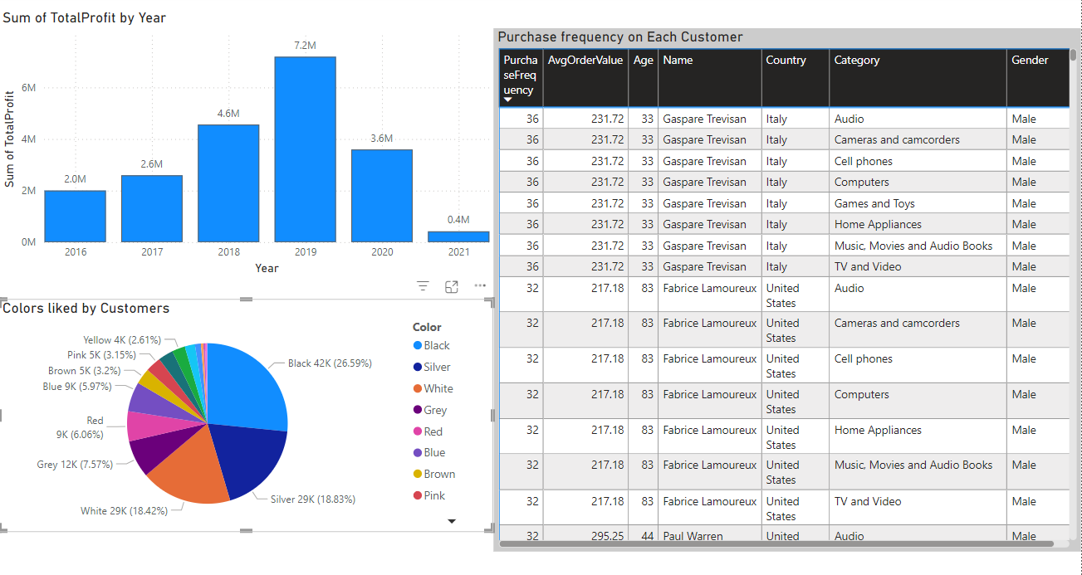

Slide 18
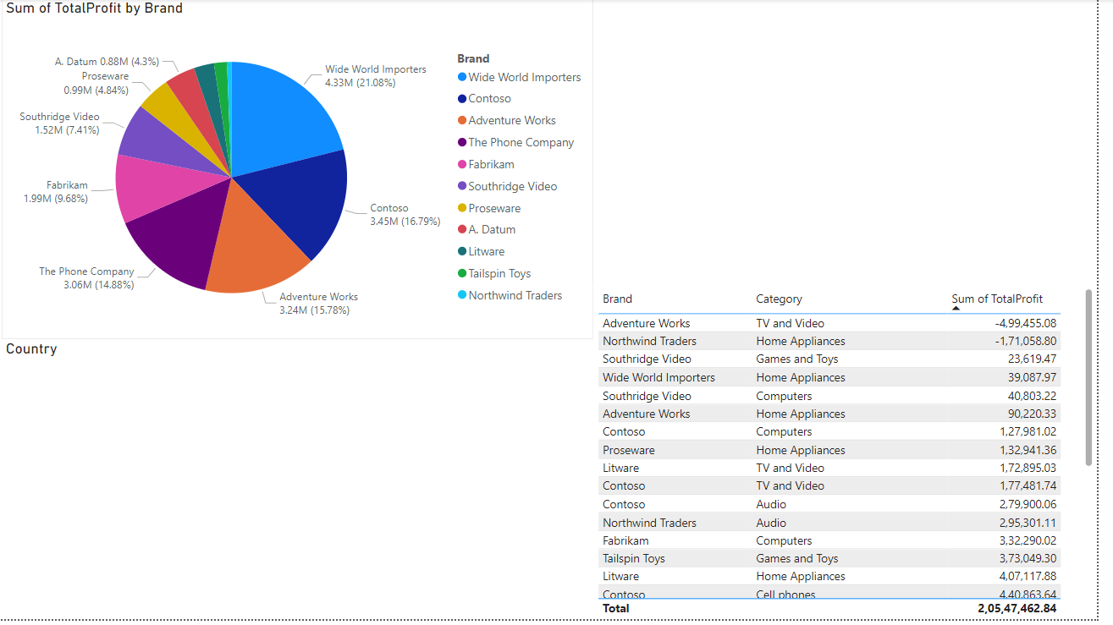

Slide 19
Conclusion
This Analysis provide a comprehensive understanding of Global Electronics’ business operations and customer base, enabling more informed decision-making and strategic planning

